Slide 1


DEPARTMENT OF INFORMATION SCIENCE & ENGINEERING
“ KEYLOGGER ”
COURSE NAME : MINI PROJECT
COURSE CODE: 20ISE391A
Presentation by,
NAME : Akshith Krishnan
Aslam Asgar Khan
USN : 1NH20IS011
1NH20IS020
Under the Guidance of ,
Guide Name : Mrs Vandana C P
Designation: Senior Assistant Professor
Team No: 34

Slide 2

Agenda
Introduction
Abstract
Application
Limitations of Existing System
Add ons
Objectives
Design modules
Algorithm / Flow chart
Conclusion
Reference

Slide 3

Introduction
Keylogger is a computer program that records every keystroke made by a computer user, to gain fraudulent access to passwords and other confidential information.
Keylogging is also known as Keystroke logging.
It can also be used to study human–computer interaction.

Slide 4

Abstract
The program requires the pynput library to monitor the keystrokes on the keyboard.
The code is return in a format where 4 user defined functions are created
which is the ‘press’ of a key and the ‘release‘ is monitored and if the user hits ‘escape’ the user is out of the logger and No. of Characters is to make ‘n’ No. of Characters come out of the loop .
The ‘press’ function is guided to a ‘log text’ file which will be controlled by a series of ‘file handling functions’ (write ,read and append ) which stores and monitors the actions or the strokes by the user .
This is done with the help of key and listener from the pynput library and the data is stored with the help of a ‘list’ which stores the keystrokes .
From this project we are looking forward to explore and learn python.

Slide 5
Application
Hackers may use them to maliciously gain access to your private information .
Employers might use them to monitor employee activities.
IT Troubleshooting .
To watch unauthorized user activity on web page.
And lot more..

Slide 6

Liretarature survey / Existing systems
API-Based Keyloggers
Form Grabbing-Based Keyloggers
Kernel-Based Keyloggers
Hardware Keyloggers
Acoustic Keyloggers

Slide 7
ADD ONS
Using Simple Mail Transfer Protocol (SMTP).
Login through the users email id and send updates through the mail .
Every time a key is typed the user gets a mail about the keystrokes .

Slide 8

Objectives
Keyloggers can sometimes be used as a spying tool to compromise business and state-owned company's data.
The main objective of keyloggers is to interfere in the chain of events that happen when a key is pressed and when the data is displayed on the monitor as a result of a keystroke

Slide 9
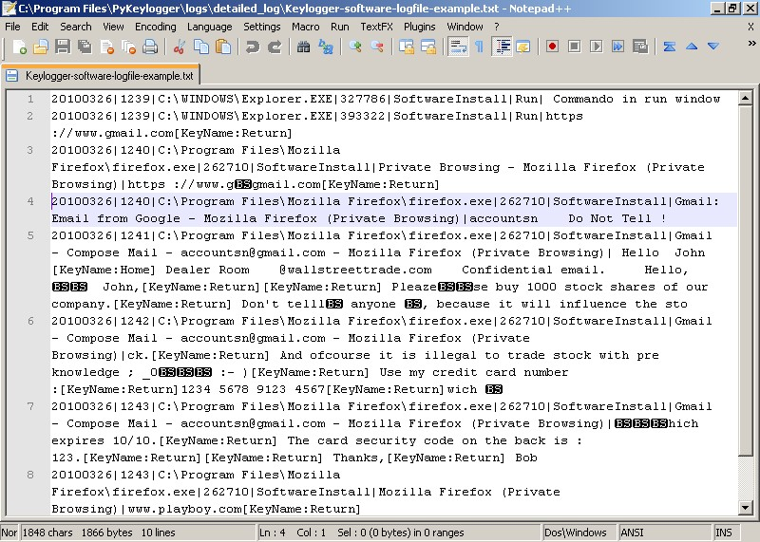
Design Modules

Slide 10

Algorithm / Flowchart
Import pynput and from pynput import Key and Listener functions .
These functions monitors the keyboard which helps us to store the values or the keys pressed in a text file (ex:log.py or .txt). There are 3 functions to be defined : a) the press function b) the release function c) the write function d) No. of Characters function The press function prints the key pressed till the n number of characters. The release function is to break out of the loop or the program when escape is pressed. The write function opens or creates a new file to store the log or the inputs in the text file(Access mode can be in append mode ). The keys are stored in a empty list and using the append function the keys keeps getting updated.
The No. Of Characters functions is to make sure that ‘n ‘ No. of Characters comes out of loop and gets stored in a memory .

Slide 11

HOW TO PROTECT YOURSELF FROM KEYLOGGERS
Implement Two Factor Authentication
Use of Virtual Keyboard
Use a comprehensive security system

Slide 12
Conclusion
Keystroke logging attacks bypass all other controls.
They are easy to implement and manage, providing attackers with useful account, identity, and intellectual property information.
On the other hand, they are useful investigative tools.

Slide 13
Conclusion
It is advisable to stay vigilant with a proactive and comprehensive security system like Comodo Advanced Endpoint Protection to combat against even the most deadly keylogging activities.

Slide 14

References
Pynput book : https://buildmedia.readthedocs.org/media/pdf/pynput/latest/pynput.pdf Functions and sample algorithms about pynput : https://pypi.org/project/pynput/ About keyboard events in windows : https://pythonhosted.org/pyglet/programming_guide/keyboard_events.html

Slide 15

Thank you

